Slide 1

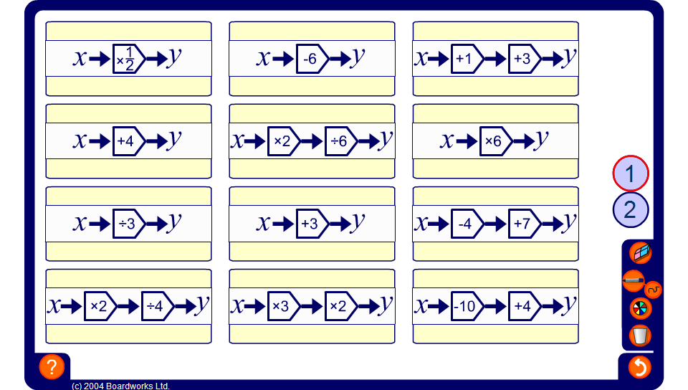


Equivalent function match
Notes:
Use this activity, to match equivalent functions.
Level 1, matches functions with two operations to their single operation equivalent.
Level 2 is much more challenging and matches functions that add (or subtract) first and multiply (and divide) second with the equivalent function that multiplies (or divides) first and adds (or subtracts) second.
After some practice pupils will notice that the operation that multiplies or divides will remain unchanged in the equivalent function. The addition or subtraction, when it appears before the multiplication or division, will be multiplied or divided in the equivalent function.
Show that two functions are equivalent by using the same input in both functions and observing that the same output is produced.
These equivalent functions can be found by writing the function algebraically.
For example, 2(x + 1) is equivalent to 2x + 2 (by multiplying out the bracket). This means that ‘add 1 and multiply by 2’ is equivalent to ‘multiply by 2 and add 2’.
2x + 2 can be shown to be equivalent to 2(x + 1) by factorizing.
Also, ^{x + 6}/₂ is equivalent to ^{x}/₂ + 3 (by dividing both terms in the numerator by the denominator). This means that ‘add 6 and divide by 2’ is equivalent to ‘divide by 2 and add 3’.
^{x}/₂ + 3 can be shown to be equivalent to ^{x + 6}/₂ by writing both terms over a common denominator, 2.

